Slide 1

Employee Attrition Prediction Using Machine Learning Algorithms

Slide 2
Abstract
Machine Learning is a branch of artificial intelligence that leverages data to imitate the pattern by which a human brain learns, in the process improving accuracy. Statistical principles are used to process data and learn from it efficiently. Machine Learning algorithms are extensively used to predict future outcomes based on past experiences that were recorded in a meticulous manner. These past experiences or data can help us to deduce preliminary insights about the data and what it represents. The current paper discusses certain Machine Learning algorithms where the prime objective is to classify the inputs into one of the two categories. The dataset in focus is the employee attrition dataset that gives various insights regarding the presumably reasons behind an employee leaving the job. The factors such as accuracy, precision score, recall score and f1_score for Random Forest, XGBoost, Adaboost, Gradient boosting and Decision Tree Classifier have been ascertained and compared. Furthermore, Hyperparameter tuning, using the ‘RandomSearchCV’ python library is also implemented on the better performing algorithms, with the goal of achieving better performance.
Keywords: Machine Learning, Random Forest, XGBoost, Adaboost, Decision Tree, Gradient Boost, Hyperparameters, RandomSearchCV.

Slide 3
Contents
Previous work
Hyperparameter Tuning
Hyperparameter working
Performance measures used
Algorithms used
Explanation of Algorithms and outputs
Future work
References

Slide 4
Previous work
A number of papers pertaining to this topic was reviewed. All of these papers predicted the employee attrition fairly well. Some of the methods used for prediction involved Naive bayes and others involved complex modules such as tensor flow.
However, a pattern was noticed in all these papers, the number of constraints used to train the model well less, making the model no very strong for complex scenarios. We have used over 30 attributes from our data set that we downloaded from kaggle.
To make our project unique, we added an extra step at the end of prediction. This step involves hyperparameter tuning the models and predicting again.
The attributes used for our research are also deeply related with the factors of an employee leaving a company which was not the case in other papers.

Slide 5
Hyperparameter Tuning
Hyperparameters contain the data that govern the training process itself.
Your training application handles three categories of data as it trains your model:
Your input data (also called training data) is a collection of individual records (instances) containing the features important to your machine learning problem. This data is used during training to configure your model to accurately make predictions about new instances of similar data. However, the values in your input data never directly become part of your model.
Your model's parameters are the variables that your chosen machine learning technique uses to adjust to your data.
Your hyperparameters are the variables that govern the training process itself.

Slide 6
Hyperparameter Working
Hyperparameter tuning works by running multiple trials in a single training job. Each trial is a complete execution of your training application with values for your chosen hyperparameters, set within limits you specify. The AI Platform Training training service keeps track of the results of each trial and makes adjustments for subsequent trials. When the job is finished, you can get a summary of all the trials along with the most effective configuration of values according to the criteria you specify.

Slide 7
Performance Measures Used
Accuracy: Accuracy represents the number of correctly classified data instances over the total number of data instances.
Precision: the number of true positives divided by the number of true positives plus the number of false positives. False positives are cases the model incorrectly labels as positive that are actually negative.
Recall: expresses the ability to find all relevant instances of a class in a data set.
F1_Score: The F1 score is the harmonic mean of precision and recall.

Slide 8
Algorithms Used
Random Forest
XGBoost
Adaboost
Decision Tree
Gradient Boost

Slide 9
Decision Tree
Decision Tree algorithm belongs to the family of supervised learning algorithms. Unlike other supervised learning algorithms, the decision tree algorithm can be used for solving regression and classification problems too.
The goal of using a Decision Tree is to create a training model that can use to predict the class or value of the target variable by learning simple decision rules inferred from prior data(training data).
In Decision Trees, for predicting a class label for a record we start from the root of the tree. We compare the values of the root attribute with the record’s attribute. On the basis of comparison, we follow the branch corresponding to that value and jump to the next node.

Slide 10
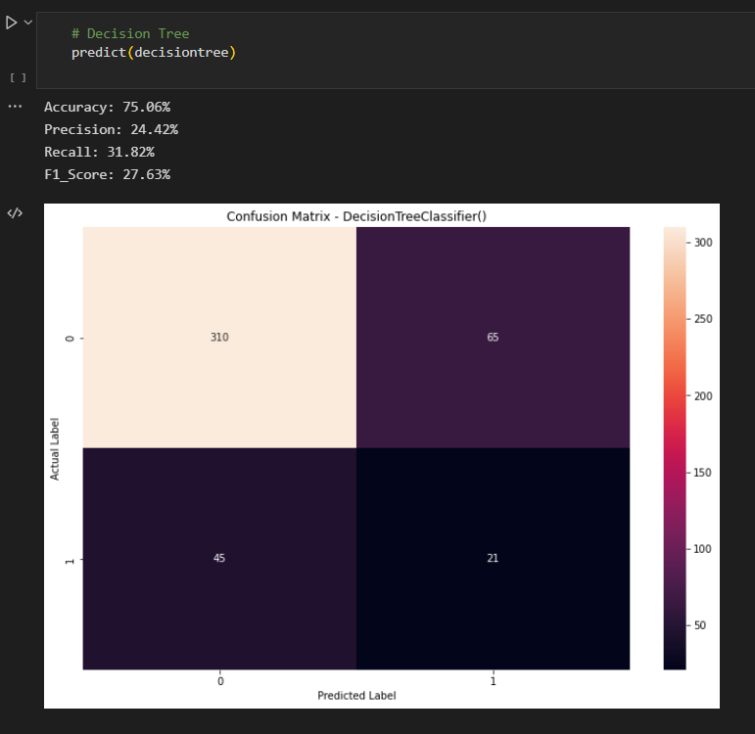

Slide 11
Random Forest
Random Forest is a popular machine learning algorithm that belongs to the supervised learning technique. It can be used for both Classification and Regression problems in ML. It is based on the concept of ensemble learning, which is a process of combining multiple classifiers to solve a complex problem and to improve the performance of the model.
As the name suggests, "Random Forest is a classifier that contains a number of decision trees on various subsets of the given dataset and takes the average to improve the predictive accuracy of that dataset." Instead of relying on one decision tree, the random forest takes the prediction from each tree and based on the majority votes of predictions, and it predicts the final output.

Slide 12
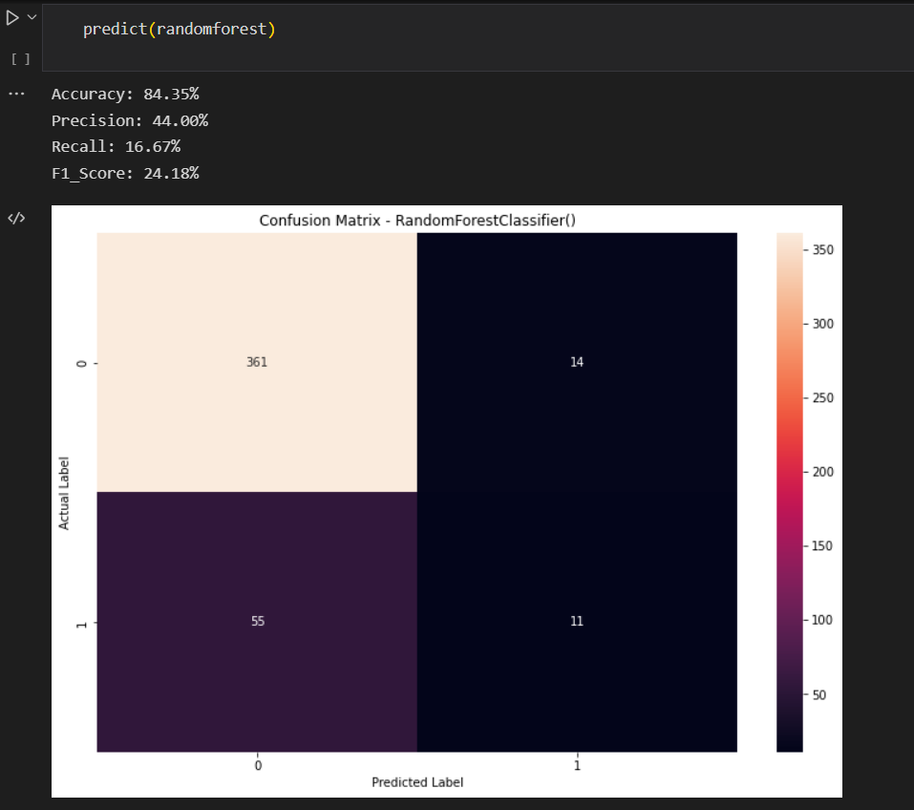
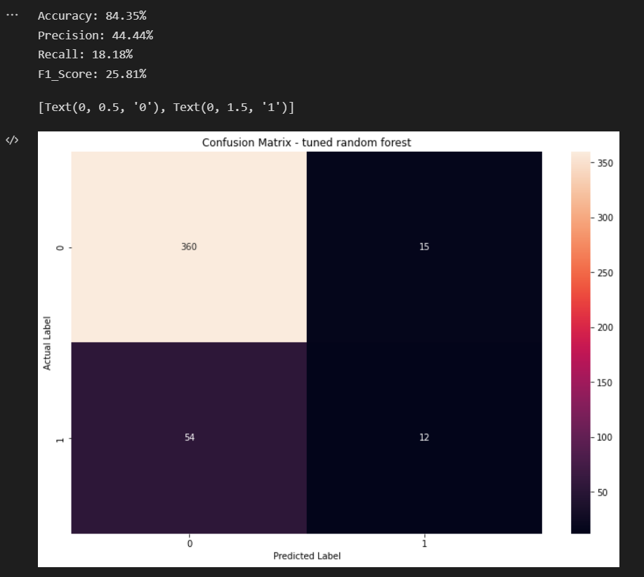

Slide 13
XGBoost
The XGBoost (eXtreme Gradient Boosting) is a popular and efficient open-source implementation of the gradient boosted trees algorithm. Gradient boosting is a supervised learning algorithm that attempts to accurately predict a target variable by combining an ensemble of estimates from a set of simpler and weaker models.

Slide 14
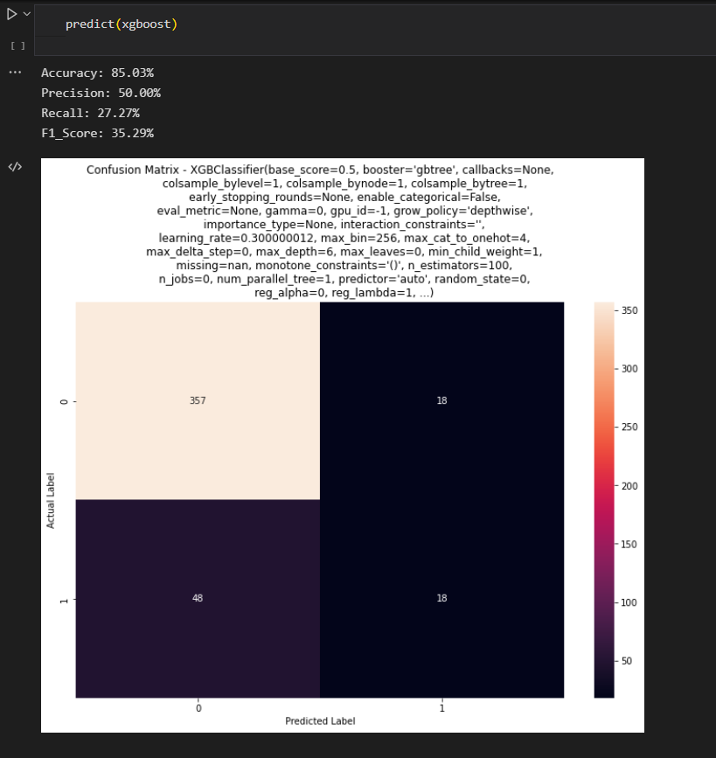
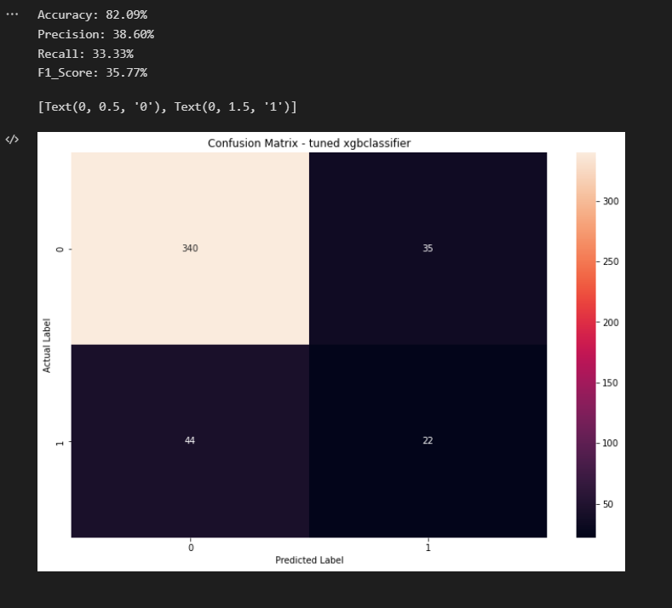

Slide 15
Adaboost
Boosting is an ensemble modeling technique that attempts to build a strong classifier from the number of weak classifiers. It is done by building a model by using weak models in series. Firstly, a model is built from the training data. Then the second model is built which tries to correct the errors present in the first model. This procedure is continued and models are added until either the complete training data set is predicted correctly or the maximum number of models are added.
AdaBoost was the first really successful boosting algorithm developed for the purpose of binary classification. AdaBoost is short for Adaptive Boosting and is a very popular boosting technique that combines multiple “weak classifiers” into a single “strong classifier”.

Slide 16
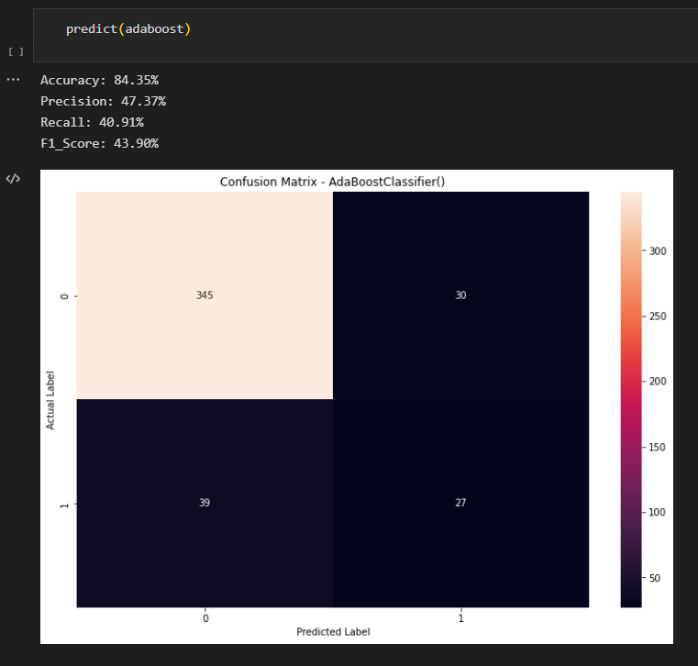
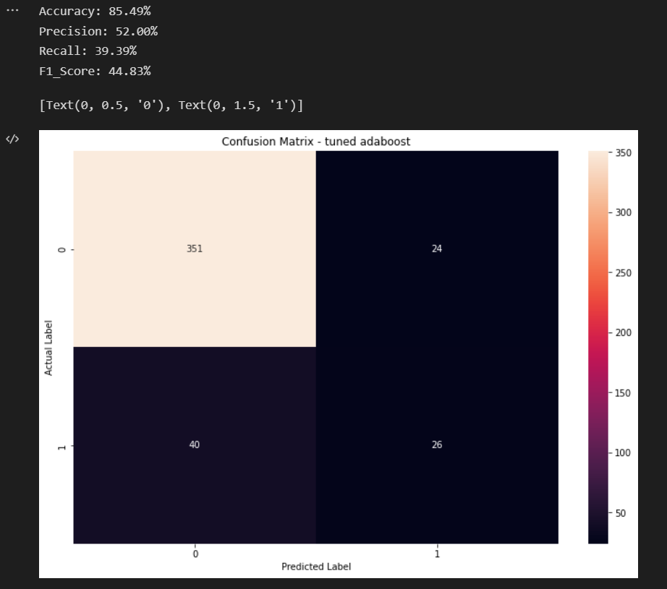

Slide 17
Gradient Boost
Gradient boosting algorithm is one of the most powerful algorithms in the field of machine learning. As we know that the errors in machine learning algorithms are broadly classified into two categories i.e. Bias Error and Variance Error. As gradient boosting is one of the boosting algorithms it is used to minimize bias error of the model.
In gradient boosting, each predictor corrects its predecessor’s error. In contrast to Adaboost, the weights of the training instances are not tweaked, instead, each predictor is trained using the residual errors of predecessor as labels.

Slide 18
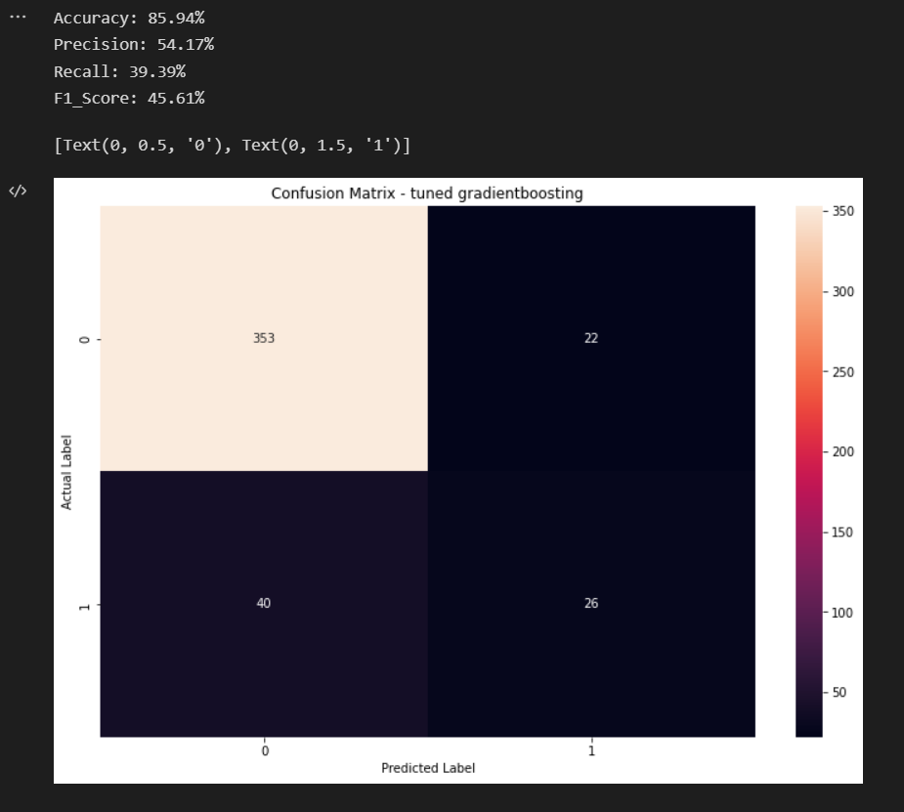
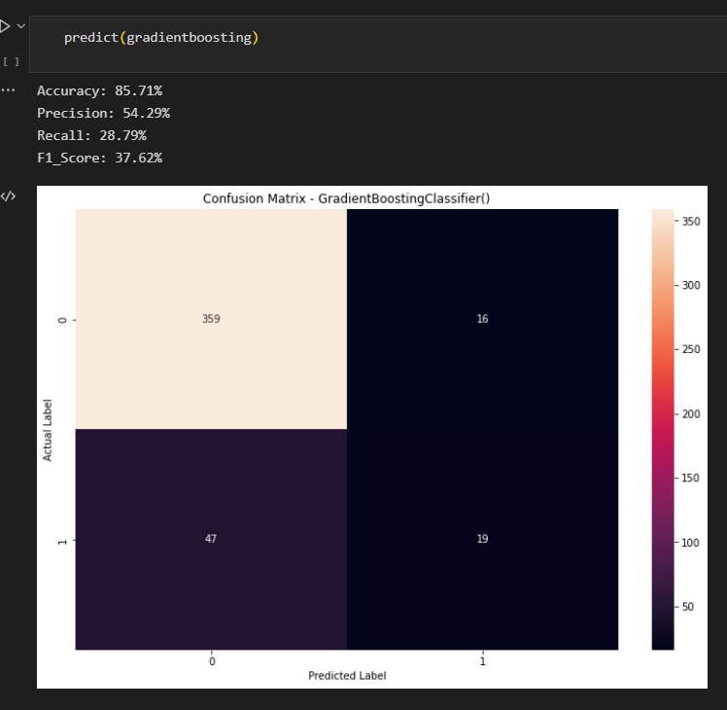

Slide 19
Future Work
Writing the paper.
Running all the models multiple times and recording the accuracy, precision, recall and f1_scores in a tabular format to find the best trained model at the end.
Draft a conclusion based on the best performing model.

Slide 20
References
[1] Shankar, R.S., Rajanikanth, J., Sivaramaraju, V.V. and Murthy, K.V.S.S.R., 2018, July. Prediction of employee attrition using datamining. In 2018 ieee international conference on system, computation, automation and networking (icscan) (pp. 1-8). IEEE.
[2] Alao, D.A.B.A. and Adeyemo, A.B., 2013. Analyzing employee attrition using decision tree algorithms. Computing, Information Systems, Development Informatics and Allied Research Journal, 4(1), pp.17-28.
[3] Alduayj, S.S. and Rajpoot, K., 2018, November. Predicting employee attrition using machine learning. In 2018 international conference on innovations in information technology (iit) (pp. 93-98). IEEE.
[4] Fallucchi, F., Coladangelo, M., Giuliano, R. and William De Luca, E., 2020. Predicting employee attrition using machine learning techniques. Computers, 9(4), p.86.
[5] Martin, L., 2020. How to retain motivated employees in their jobs?. Economic and Industrial Democracy, 41(4), pp.910-953.
[6] Jhaveri, S., Khedkar, I., Kantharia, Y. and Jaswal, S., 2019, March. Success prediction using random forest, catboost, xgboost and adaboost for kickstarter campaigns. In 2019 3rd International Conference on Computing Methodologies and Communication (ICCMC) (pp. 1170-1173). IEEE.
[7] Kabiraj, S., Raihan, M., Alvi, N., Afrin, M., Akter, L., Sohagi, S.A. and Podder, E., 2020, July. Breast cancer risk prediction using XGBoost and random forest algorithm. In 2020 11th international conference on computing, communication and networking technologies (ICCCNT) (pp. 1-4). IEEE.
[8] Bardenet, R., Brendel, M., Kégl, B. and Sebag, M., 2013, May. Collaborative hyperparameter tuning. In International conference on machine learning (pp. 199-207). PMLR.
[9] Schratz, P., Muenchow, J., Iturritxa, E., Richter, J. and Brenning, A., 2019. Hyperparameter tuning and performance assessment of statistical and machine-learning algorithms using spatial data. Ecological Modelling, 406, pp.109-120.
[10] Shi, X., Wong, Y.D., Li, M.Z.F., Palanisamy, C. and Chai, C., 2019. A feature learning approach based on XGBoost for driving assessment and risk prediction. Accident Analysis & Prevention, 129, pp.170-179.

